Slide 1
This New Discovery Could Put Quantum Computers Within Closer Reach
Jaehyung Park
May 23, 2016
CS 35L
Lab 1: Josh Vaughen

Slide 2
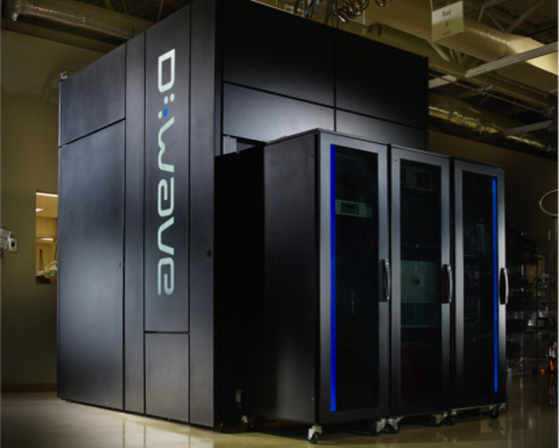
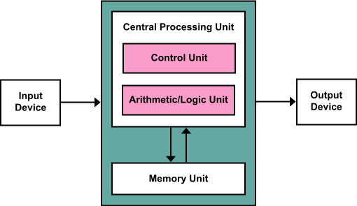
Quantum computing architecture
Modern computers follow Von Neumann Architecure that heavily relies on memory.

Slide 3
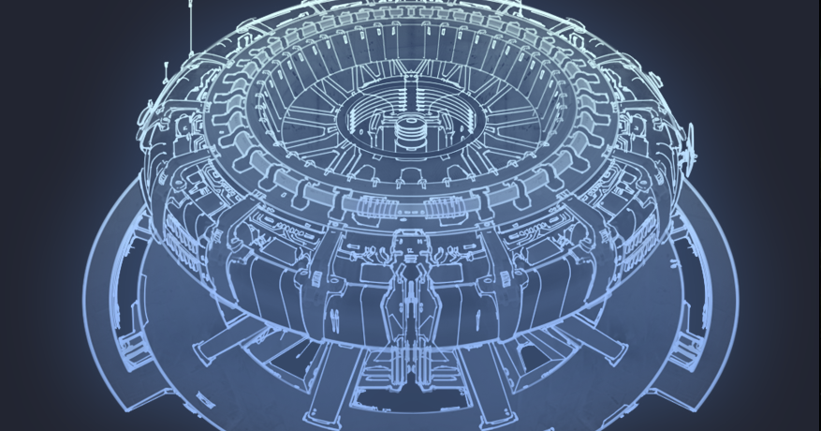
What is a quantum computer?
Definition: A computer that makes use of the quantum states of subatomic particles to store information (Reference:Oxford dictionary)
2 Qubits => Four superposition states (00, 01, 10, 11)
N qubits == 2^{N} classical bits
Notes:
팁: 발표자 노트의 내용을 추가합니다.

Slide 4
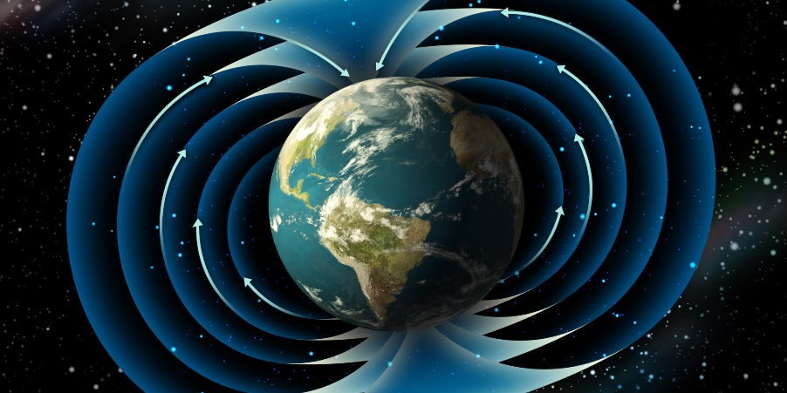
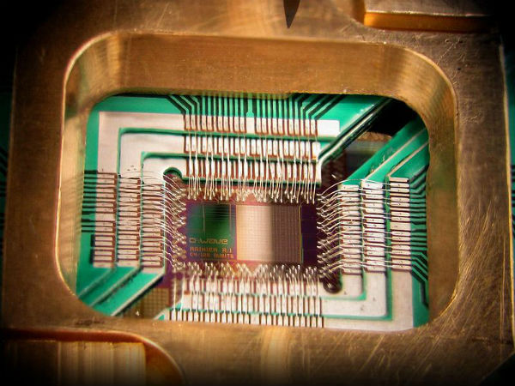

Quantum computers are prone to magnetic fields and heat

Slide 5
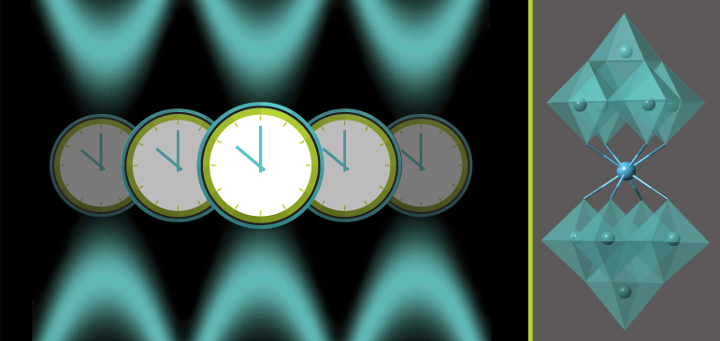
Discovery: Atomic Clock Transitions
Katherine Noyes quotes “Working with carefully designed tungsten oxide molecules that contained a single magnetic holmium ion, the MagLab team was able to keep a holmium qubit working coherently for 8.4 microseconds” (Noyes, 2016)

Slide 6
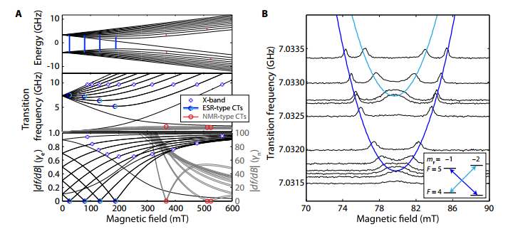
Background/Research
Electron spin resonance (ESR)-type clock transitions (CTs) of Si:Bi (Wolfowicz, 2013)

Slide 7
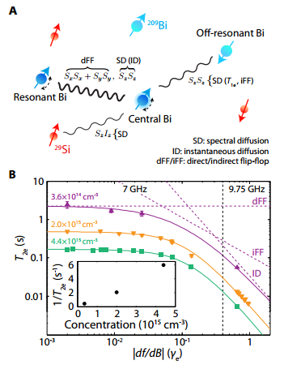
How is this going to work? Results?
Decoherence mechanisms of Bismuth (Bi) donors in Silicon (Si) and their dependence on df/dB. (Wolfowicz, 2013)

Slide 8
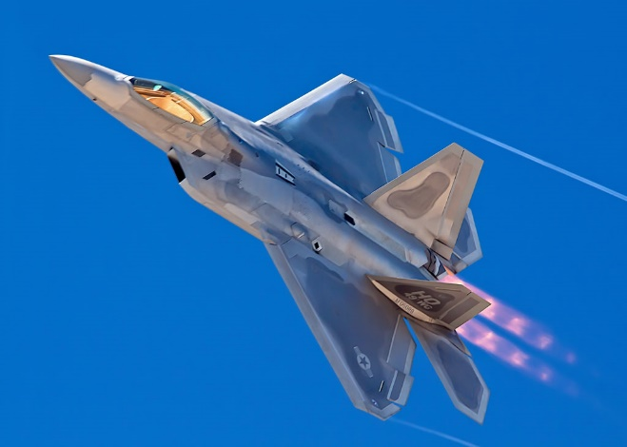

Future applications and Possibilities
Parallel computing
Military use
Artificial Intelligence
Optimization
Encryption and code breaking
Web search and Robotics

Slide 9
Reference
Noyes, K., Mar 16 2016, “This new discovery could put quantum computers within closer reach”, Computerworld <http://www.computerworld.com/article/3045046/high-performance-computing/this-new-discovery-could-put-quantum-computers-within-closer-reach.html>
Wolfowicz, G. et al., June 23 2013, “Atomic clock transitions in silicon-based spin qubits”, Nature technology, 8, pp.561-564
Shiddiq, M. et al., January 05 2016, “Enhancing coherence in molecular spin qubits via atomic clock transitions”, Nature, 531, pp.348-351
Hagar, A. and Cuffaro, M., June 2015, “Quantum Computing”, The Stanford Encyclopedia of Philosophy, <http://plato.stanford.edu/archives/sum2015/entries/qt-quantcomp/>
Meter, R.V., Horsman, C., October 2013, “A Blueprint for Building a Quantum Computer, Communications of the ACM”, Vol. 56 No. 10, pp 84-93
Weinberger, S., November 18 2014, “Why Google and the Pentagon want ‘quantum computers’”, BBC, <http://www.bbc.com/future/story/20130516-big-bets-on-quantum-computers>

